Slide 1
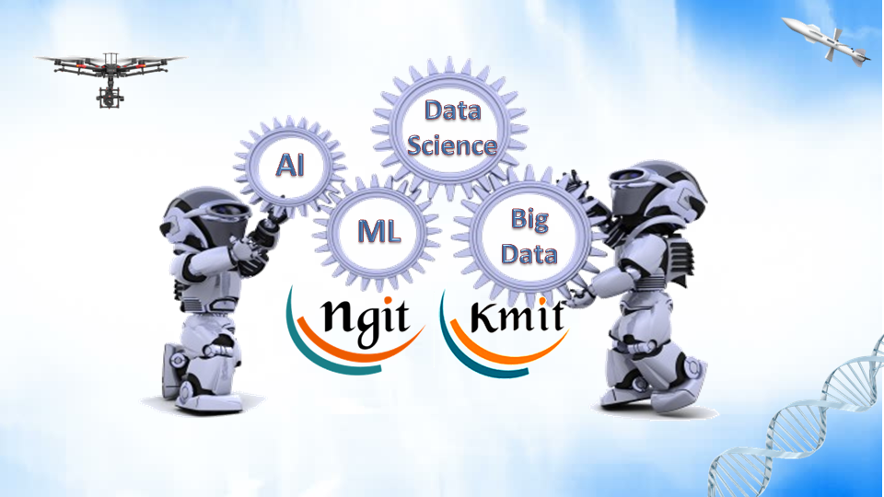
Introduction
Data Science/Machine Learning

Slide 2

Team
A Srinivas Rao
DOMAIN SCHOLAR IN DATASCIENCE

Slide 3
Course Schedule
Approach
44 Sessions
Briefing Concept
Monday – Tuesday-Wednesday –Thursday- Friday
Practical Examples
Daily 3 hours
Exercises

Slide 4
Session - 4
This session deals with
Why Data Science…?
Definition of Data Science
Various Fields in Data Science
Data Science vs Engineer vs Analyst
Data Scientist
Skill Set
Data Science Team
Activities
Steps to learn Data Science

Slide 5
Why Data Science…?
Huge amount of data is generated from last 3 decades
Examples of data generators:
Websites, Smart phones, Stock Markets
Lot of hidden information is in that data which no one can observe
Analysis is required on data to find the hidden facts
Data might be in structured/semi-structured/unstructured form
It is difficult to analyze the structured data with unstructured data
Analysis of Real-Time data is challenging task
Analysis of Big Data is challenging task
Companies like Facebook, Yahoo, Google, Linkedin started to analyze data to improve their product

Slide 6


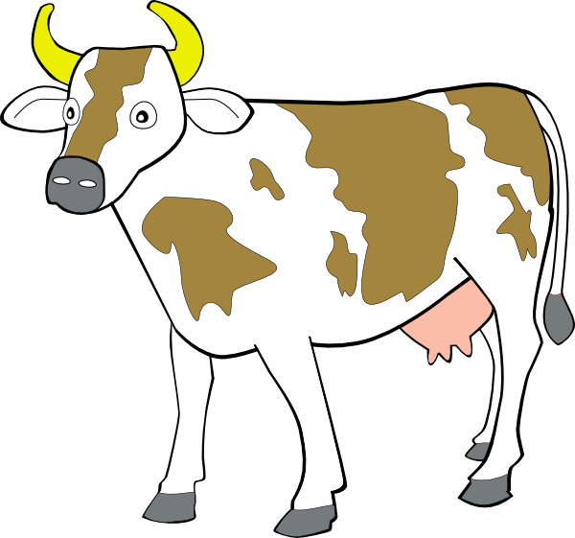






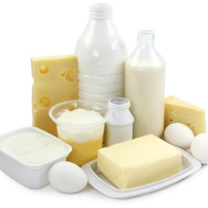

Data Science…in painless way…
Sources of Data
Data Science
Streaming
Takes Data
Produces
Data
Product

Slide 7






Definition of Data Science
Sources of Data
Data is available from various sources.
Data can be in various formats : structured/unstructured/semi-structured
It might be useful or irrelevant for a particular purpose
Data science is an art of turning data into actions by producing Data Product
Data Science
art of
turning data into actions
Data Product
Actionable Information
Takes Data
Produces
Streaming
Decision Maker
Examples:
Recommendations
Weather forecasts
Stock market predictions
Etc..

Slide 8
About Data Science…!
Data Science is an emerging field with rapid changes and opportunities
It is linked with various topics
Data Science
Mathematics
Statistics
Data visualization
Computer Science
Machine Learning
Communication
Domain Expertise
Deep Learning
The scope of data science is measureless
Manufacturing
Education
Healthcare
Sports & Games
Finance
Telecom
Many more….
Biotech
Transport & travel

Slide 9







Data Scientist vs Data Analyst vs Data Engineer
Data Scientist
Inductive Reasoning
Data Engineer
Undirected Research
Multiple resources
Warehouse
Design theses
Data Analyst
Bigdata
Programming
Database Handling
Find Problems and solutions
Data Visualization
Deductive Reasoning
Mining
Data
Management
Statistics
Machine Learning
File Handling
Use existing tools and algs

Slide 10

Data Scientist
A person who puts efforts in all activities of data science…
Intangible x-factors
Tangible technical skills
Curiosity : to peel apart a problem and examine interrelationships between data.
Able to generate Hypothesis
Data must be acquired, prepared, analyzed and acted.
Creativity : to invent and try new approaches
Computer Science
Mathematics / Statistics
Focus : to design and test technique over days and weeks, learn from failure and try again
Domain Expertise

Slide 11
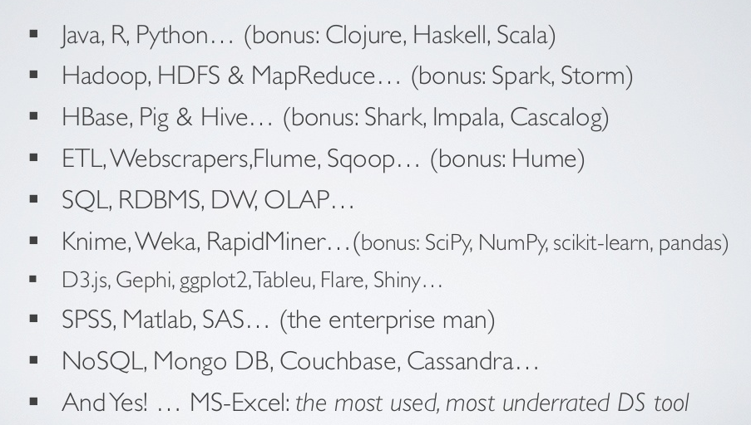
DS/Machine Learning Tool Kit

Slide 12
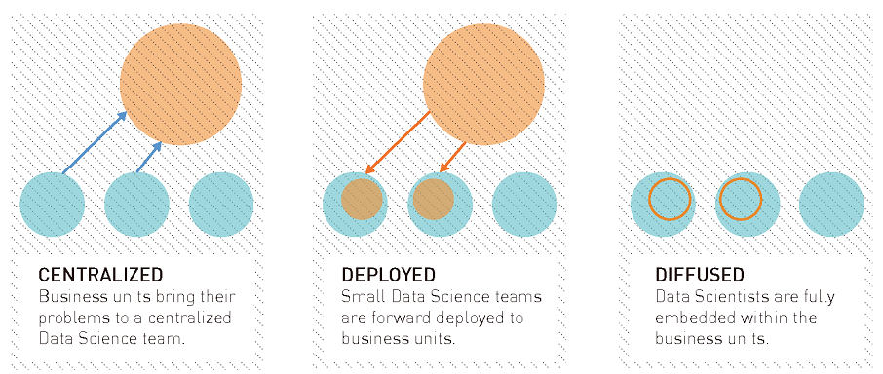
Data Science Team
Operating Models:
There are 3 operating models

Slide 13

Data Science Team
Balancing Team Equation
It is like balancing the chemical reaction.
Requirement
Recruitment
2 teams with 1 Computer Science and 2 Mathematics
4 Computer Science
2 teams with 1 Computer Science each
5 Mathematics
1 Team with 1 mathematics and 1 domain expert
1 Domain Expert

Slide 14

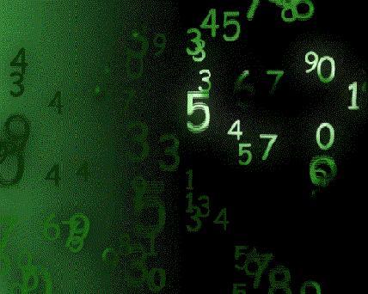












Major Activities in Data Science
(Student – Job)
Data Science
Sources of Data
Acquire – Collect data
Prepare – Data Lake
Req. Skills
Data Lake
Student DB
Looks for…
Current Updates
Old Student Data
Decision Maker
Analyze – Process
Analyzed Data
Current skills required for students
Job Holders
Alumni
Act – Use data
Builds
All updates
Analytics
Finding for each student opportunities
Notifications

Slide 15
Major Activities – Required Skills
Data Science
Acquire – Collect data
Analyze
Machine Learning: to design hypothesis and analytics
Computer Science : to collect useful data from various sources
Domain Expertise: to ensure for relevant data analysis
Domain Expertise: to take relevant data
Computer Science: to create hypothesis and analytics
Prepare – Data Lake
Act – Use data
Computer Science: to create and maintain Data Lake
Domain Expertise: to find relevant questions and answers
Domain Expertise: to ensure for relevant data
Computer Science: to present in effective way for decision maker

Slide 16
Steps to Learn Data Science
Data Science
Machine Learning
Deep Learning
Big Data
Visualization

Slide 17
What Is Machine Learning…?
Machine Learning is the science (and art) of programming computers so they can learn from data
Machine Learning is the field of study that gives computers the ability to learn without being explicitly programmed
A computer program is said to learn from experience E with respect to some task T and some performance measure P, if its performance on T, as measured by P, improves with experience E
T
P
Output
Exp1
Exp2
…

Slide 18

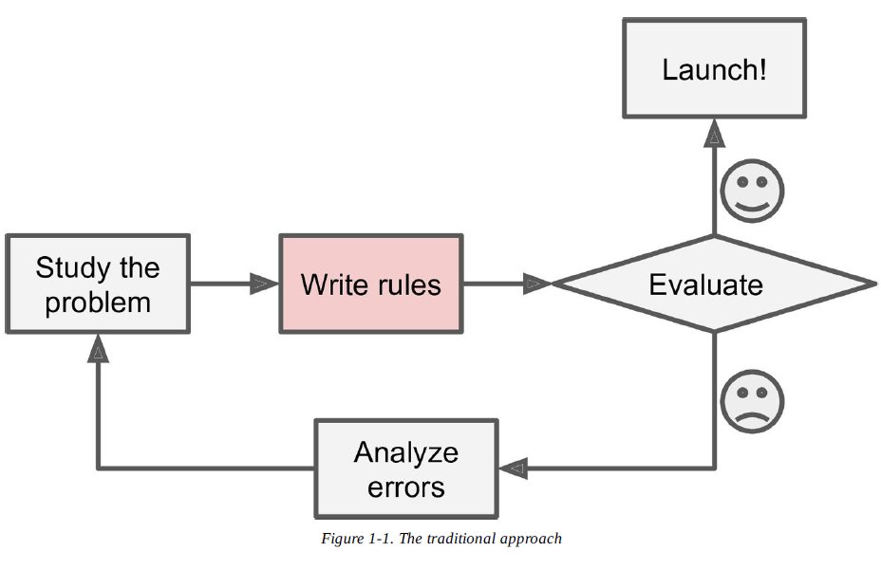
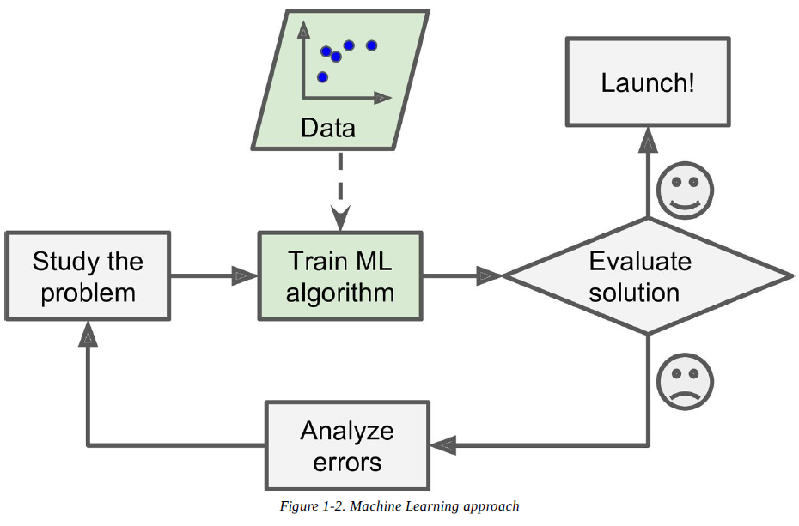


Traditional / ML
Traditional
Machine Learning

Slide 19
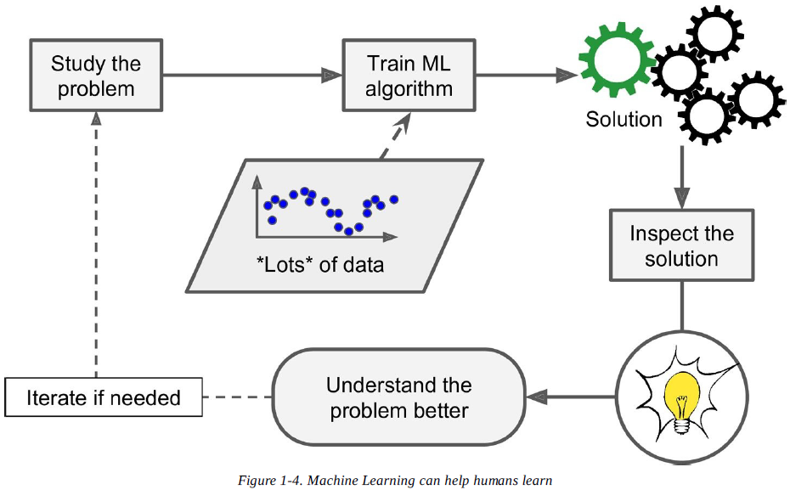
Machine Learning Flow

Slide 20
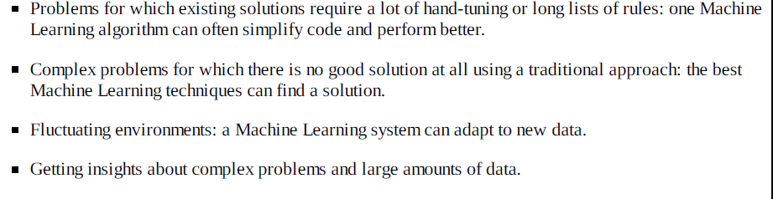
Where ML fit for…?

Slide 21
Machine Learning in various fields
Predicting Lifetime Value, Wallet share estimation, Product mix, Recommendation Systems, Discount targeting, channel optimization
Marketing
Sales:
Lead Prioritization, Demand forecasting
Medical resources allocation, Claims review prioritization, Survival analysis, Medication effectiveness, re-admission risk
Healthcare:
Consumer Financial:
Credit card fraud
Retail :
Pricing, Location of stores, Warranty analysis,
Claims prediction, Claims Handling, Investments, Agent & Branch performance
Insurance:
Aircraft Scheduling, Seat management, Dynamic pricing, Call-center stuff, Tourism forecasting
Travel:
Human Resources
Resume Screening, Employee churn, Training Recommendation, Talent Management

Slide 22
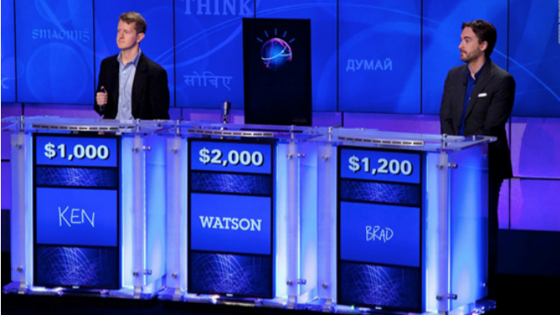
Machine Learning - Examples
IBM’s Watson:
Jeopardy-playing supercomputer (https://www.youtube.com/watch?v=WFR3lOm_xhE)
Learning from its mistakes
Watson’s software is wired for handling natural language processing
It’s machine learning allows the computer to become smarter as it tries to answer questions — and to learn as it gets them right or wrong

Slide 23
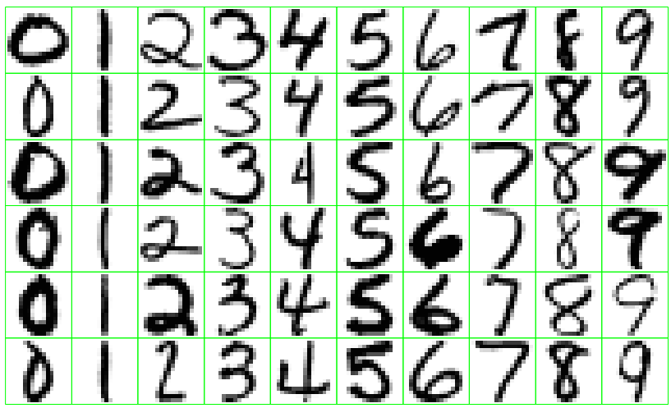
Machine Learning - Examples
Identify the numbers in a handwritten zip code.
0-9 digits taken from different persons
Human can recognize easily the patterns
Difficult for a machine to recognize patterns
It requires neural networks

Slide 24
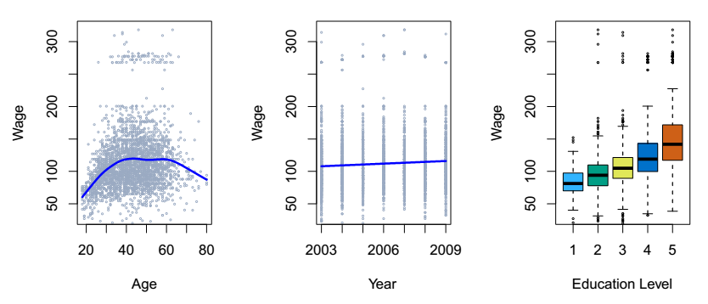
Machine Learning - Examples
Establish the relationship between salary and demographic variables in population survey data.
Age between 30 and 60
Over the years not much impact
Higher education level

Slide 25
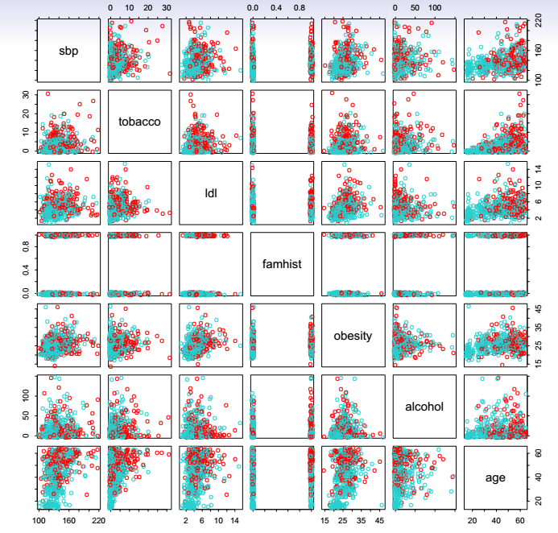
Machine Learning - Examples
Predict whether someone will have a heart attack on the basis of demographic, diet and clinical measurements.
Spontaneous bacterial peritonitis (SBP)
Tobacco
LDL: The 'Bad' Cholesterol
Family History
Obesity
alcohol
age
Red bubbles – Heart Decease

Slide 26
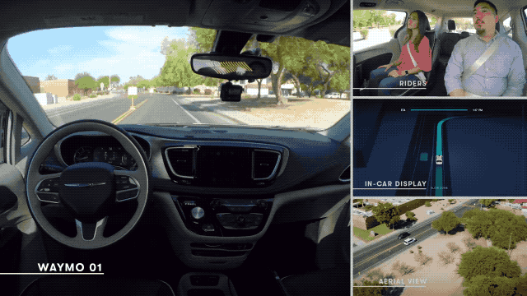
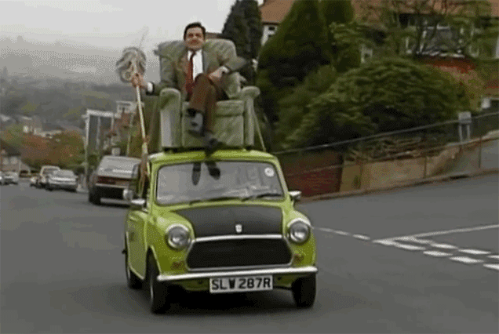
Machine Learning - Examples
Autonomous Cars

Slide 27
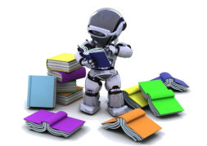
Types of ML Systems
Machine Learning
Based on data flow
Based on Reasoning
Incremental/Online
Batch
Deductive / Model-based
Inductive / Instance Based
Based on Human Supervision
Supervised
Unsupervised
SemiSupervised
Reinforcement

Slide 28
Machine Learning Approaches
Deductive reasoning – Theory to Observations (Top-down )
arguments are either valid or invalid
Inductive Reasoning – Observations to Theory (Bottom-up)
arguments are either strong or weak
Theory / Hypothesis
Deductive Reasoning
Possibilities==theory/rules
Conclusions
Possibilities
Inductive Reasoning
Generalize observations
Hypothesis / Theory
Observations
Science : There is a constant interplay between inductive inference and deductive inference until we get closer and closer to the 'truth'

Slide 29
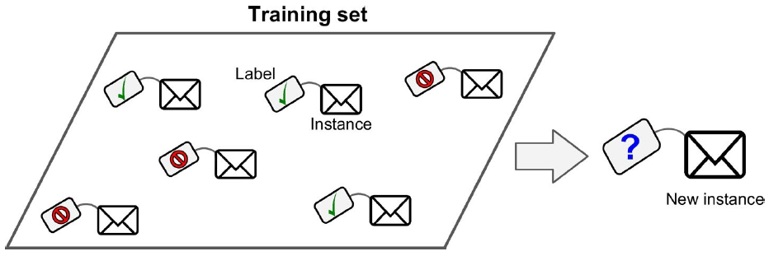
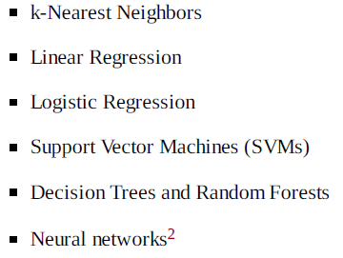
Supervised Learning
Classification
Class | Percentage
10th | 62
Intermediate | 78
Graduation | X
PG | 85
Regression
Class | Percentage
Graduation | 82

Slide 30
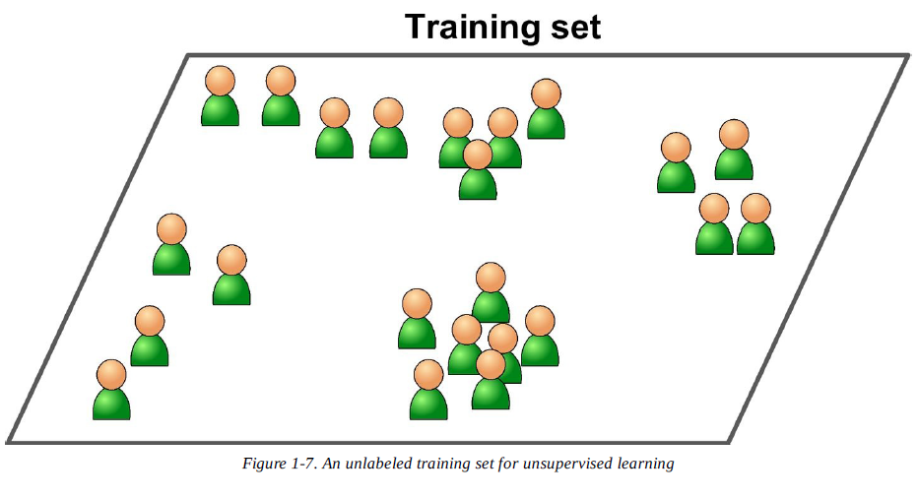
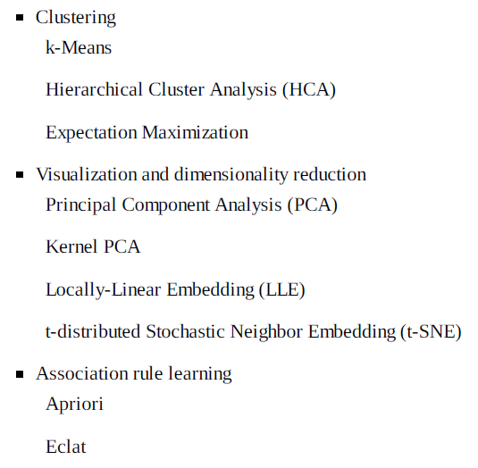
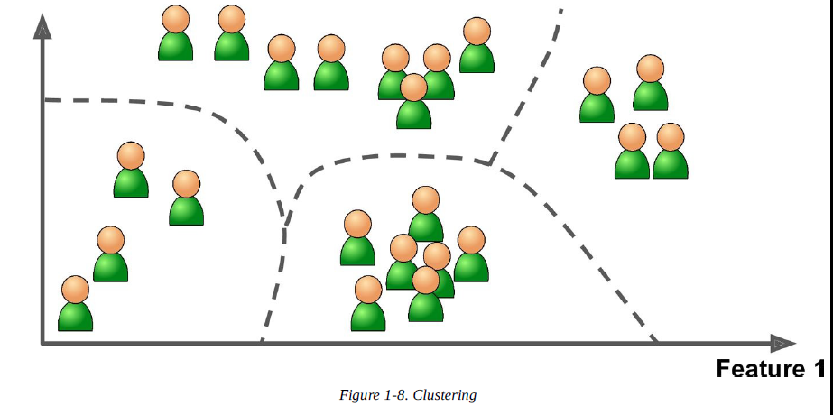
Unsupervised Learning

Slide 31
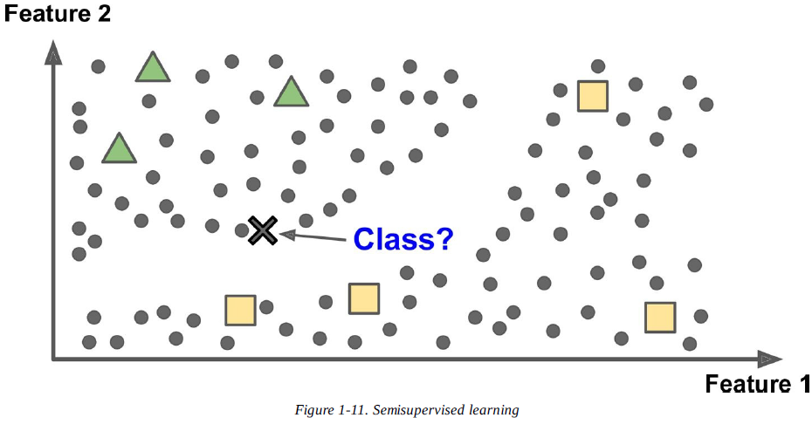
Semi-supervised Learning
Photo identification in google

Slide 32
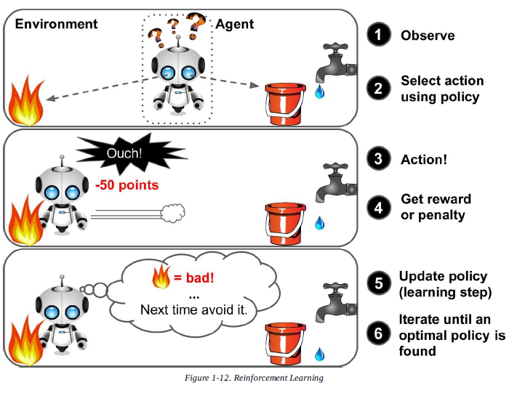
Reinforsement Learning

Slide 33
Limitations
Insufficient quantity of training data
Nonrepresentative Training Data
Poor-Quality Data
Irrelevant Features
Overfitting the Training Data
Underfitting the Training Data

Slide 34






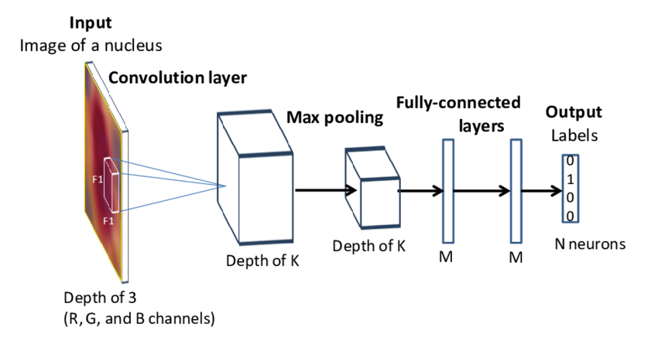

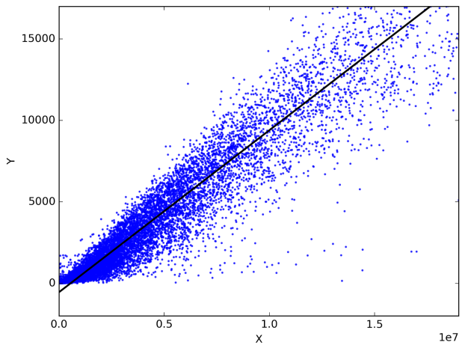

Course Structure
IDE
Language
Pandas
Machine Learning

Slide 35
Syllabus
Stage-I
(Prerequisites)
Stage – II
(Machine Learning)
Stage – III
(Deep Learning)
Numpy
Linear Regression
Pandas
Polynomial
ANN
Matplotlib
Gradient Descent
CNN
Logistic Regression
Preprocessing Data
RNN
Decision Trees
Semantic Segmentation
Random Forest
Reinforcement Learning
Advanced Techniques

Slide 36
Session - 1
Conclusion
You are aware of
What is Data Science
What is Machine Learning
Types of Machine Learning
We will proceed with
Numpy

Slide 37


